Slide 1
UNCERTAINTY QUANTIFICATION OF AGENT-BASED MODELS WITH APPLICATION TO MALARIA INTERVENTION MODELING
PhD Student: Zenabu Suboi
First Supervisors: Dr. Emilie Pothin
Prof. Dr. Christian Lengeler
Dr. Christian Selinger
Second Supervisor: PD Dr. Amanda Ross

Slide 2
Background training
Education
Current Work Experience
Feb 2024 - Ongoing 01.2019 – 12.2020 08.2017 – 06.2018 | PhD Candidate, Epidemiology Swiss Tropical & Public Health Institute/ University of Basel, Switzerland Master in Mathematics, Stellenbosch University, South Africa Master in Mathematical Science, AIMS – South Africa
09.2012 – 06.2016 | Bachelor in Statistics, University for Development Studies, Ghana
10.2021 – Date | Assistant Lecturer at Academic City University College, Ghana

Slide 3
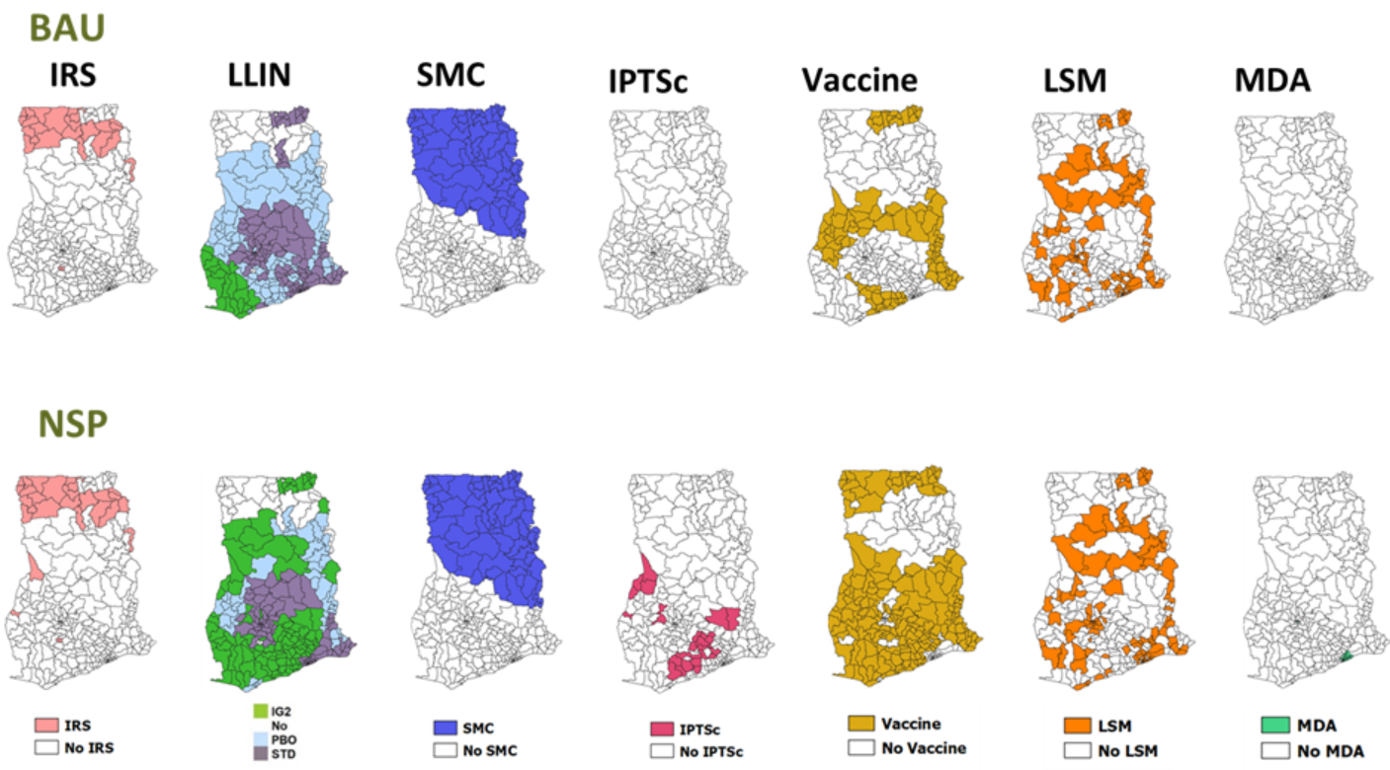
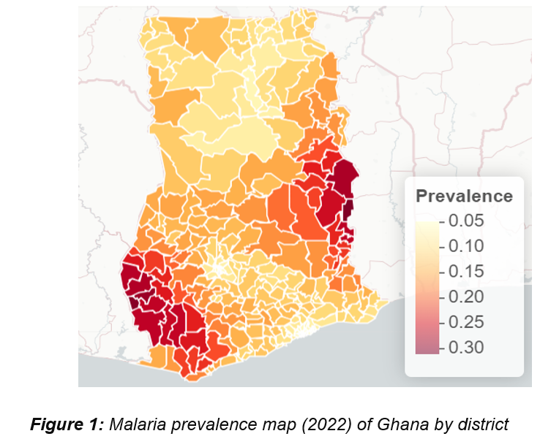
Malaria Prevalence in Ghana is highly heterogeneous
OpenMalaria is used to simulate the impact of interventions for sub-national tailoring
Source: NMEP, figure by: ZS

Slide 4
Uncertainty in Agent-Based Model outputs stem from different sources
Model uncertainty
Stochastic uncertainty
Parameter uncertainty
Observation uncertainty
Model output
Notes:
In the context of ABMs, there are several acknowledged sources from which uncertainty can originate and then propagate through the model.
there are often uncertainties in the real-world process that an ABM is designed to simulate. This can be because any observations taken are inaccurate or because the system is stochastic and, therefore, multiple observations lead to different results

Slide 5
EIR is not the only source of Parameter Uncertainty in Intervention Modeling
EIR
Parameter uncertainty
ITN effective coverage
SMC effective coverage
Vaccine effective coverage
Notes:
To address uncertainties, we identify and quantify the various sources of uncertainty in intervention modeling

Slide 6
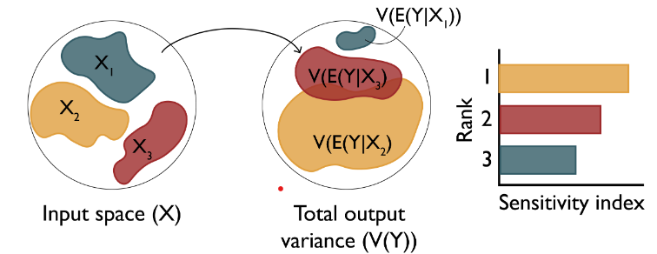
Research Objectives
Objective 1: Understand the key drivers of impact of malaria interventions in Ghana
Objective 3: Simulate the impact of malaria interventions in Ghana in order to support decisions for strategic planning
Objective 2: Develop a novel inference framework for calibrating the OpenMalaria model at a higher spatial resolution
Perform sensitivity analysis of coverage, halflife of efficacy and vector composition towards prevalence reduction and clinical cases averted (Forward propagation)
Results of the sensitivity analysis will help the NMEP to carefully choose intervention re-allocation if needed, during the midterm review
The sensitivity analysis will be integrated in the OpenMalaria workflow package, which will be publicly available
Source: Sensitivity Analysis: The Basics

Slide 7
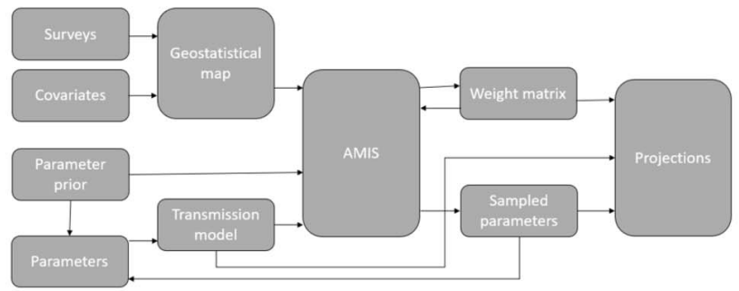
Research Objectives
Objective 1: Understand the key drivers of impact of interventions in Ghana
Objective 3: Simulate the impact of malaria interventions in Ghana in order to support decisions for strategic planning
Objective 2: Develop an efficient inference framework for calibrating the OpenMalaria model at a higher spatial resolution
Develop framework to infer multiple parameters and perform uncertainty quantification for malaria interventions applied to the Ghana data (Inverse uncertainty quantification)
a fully implemented, tested, and documented sampling-based inference framework. This framework will be used to calibrate the OpenMalaria Ghana model
Source: Retkute et al.

Slide 8
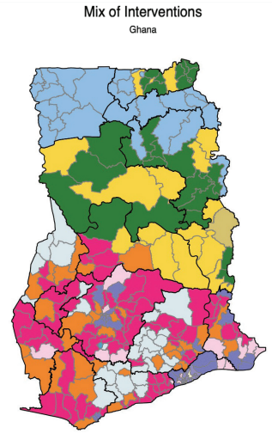
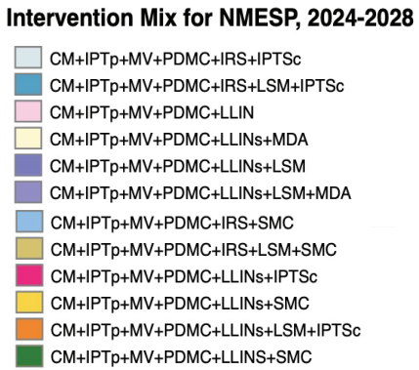
Research Objectives
Objective 1: Understand the key drivers of impact of interventions in Ghana
Objective 3: Simulate the impact of malaria interventions in Ghana in order to support decisions for strategic planning
Objective 2: Develop a novel inference framework for calibrating the OpenMalaria model at a higher spatial resolution
refine modeling scenarios for Ghana at the sub-national (district) level and define prioritization criteria for combinations of interventions
Source: Ghana NMESP 2024-2028.

Slide 9
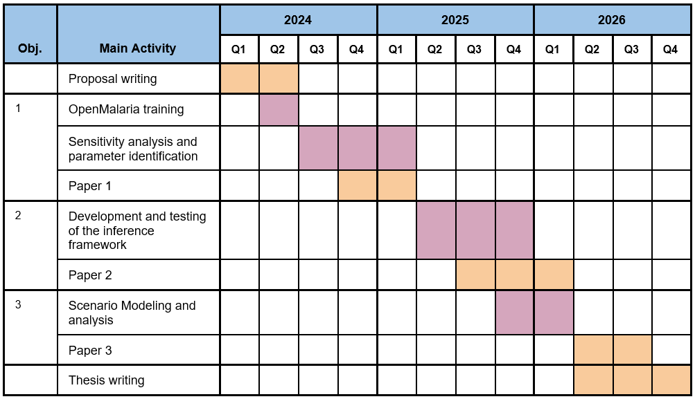
Time Plan

Slide 10
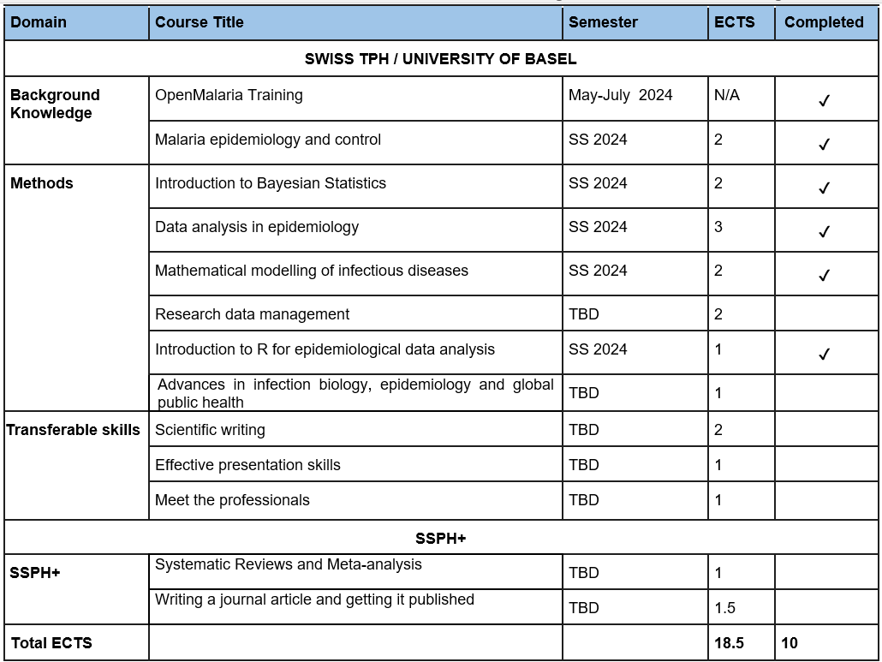
Planned Training During PhD

Slide 11
THANK YOU

